Slide 1

#KidzHackPhilly
Lesson 2: CPU and programs

Slide 2

Today’s lesson
Review (10 min)
Hardware lesson (20 min)
Software lesson (20 min)
Challenge (10 min)

Slide 3

Review

Slide 4

Hardware lesson
CPU

Slide 5
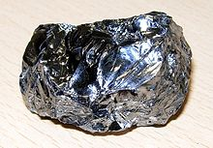

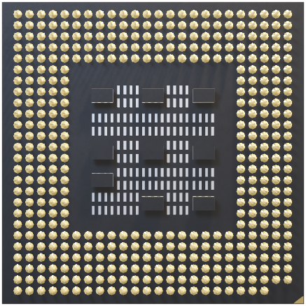
CPU
CPU stands for “Central Processing Unit”
CPU’s execute instructions
Math: 4 * 9 = 36
Logic: if, and, or, not
Control: Goto, start, quit
Input/output: Print, ring bell
Early CPU’s could process thousands of instructions per second
CPU’s are manufactured in a “clean room”
Silicon is one of the primary materials used to manufacture CPU’s
Modern CPU’s are known as “microprocessors”
Cores are additional CPU’s, a “chip on a chip”!
“Moore’s Law” predicted that the processing power in microprocessors would double every two years
Modern microprocessors can process billions of instructions per second

Slide 6

Software lesson
Programs

Slide 7
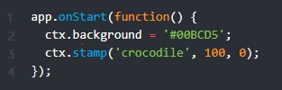

Programs
A program is a collection of instructions to be executed by a CPU
Programs are written in a variety of different languages
We will learn a language called “JavaScript” to start
Using the Kano Code app you can write JavaScript code using blocks
Here’s a JavaScript program that draws a crocodile on a blue canvas
Line 2 sets the color to blue using hexadecimal notation
Line 3 draws a crocodile using the “stamp” method

Slide 8

Hands on
Complete a challenge that shows how to write JavaScript programs using code blocks in Kano Code.
Make changes to the challenge.
See README.md for step-by-step instructions.

